Slide 1
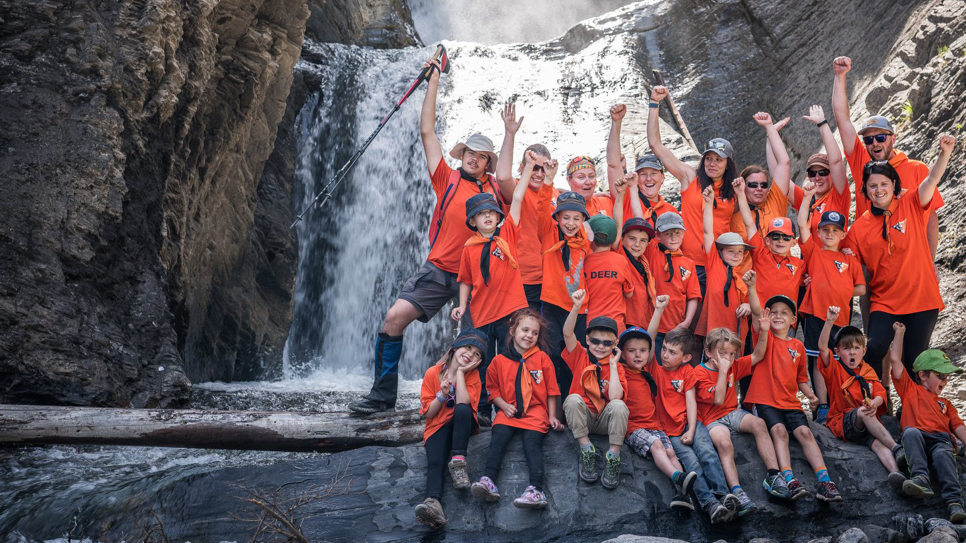

Welcome to
ADVENTURE and FUN
Scouts.ca

Slide 2
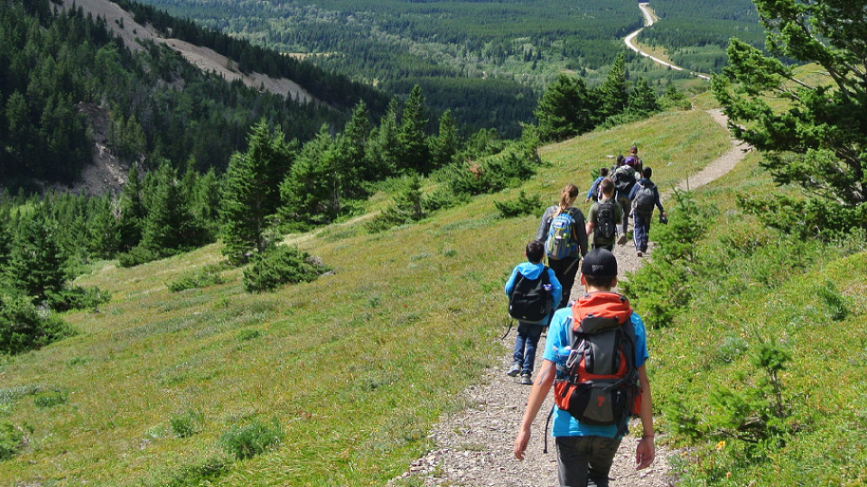
Scouts
chart their
own path.
Through a variety of fun experiences with friends, outdoor adventures and contributions to their
community, Scouts build
resilience and skills that
set them up for life.​

Slide 3
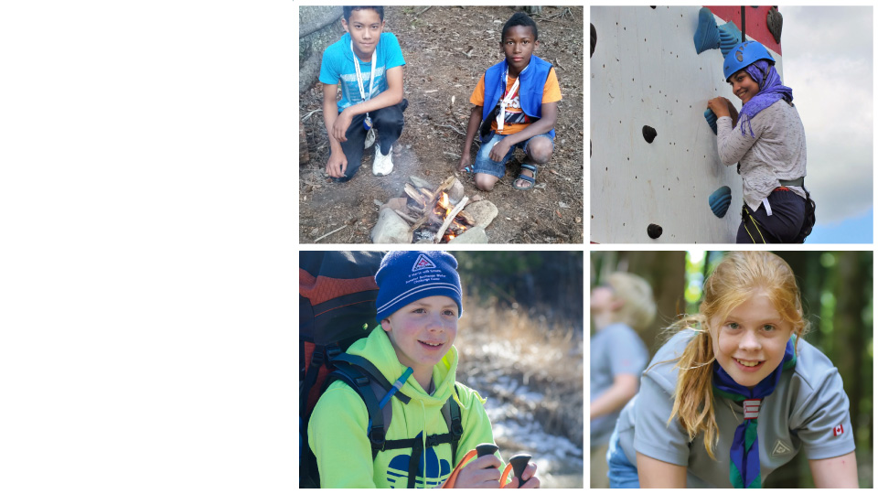
We focus on age-appropriate activities that build skills and promote inclusivity and collaboration—all while having fun with new friends. Here’s what you can expect…
Scouting
isn't an activity or a setting—it’s a discovery.

Slide 4
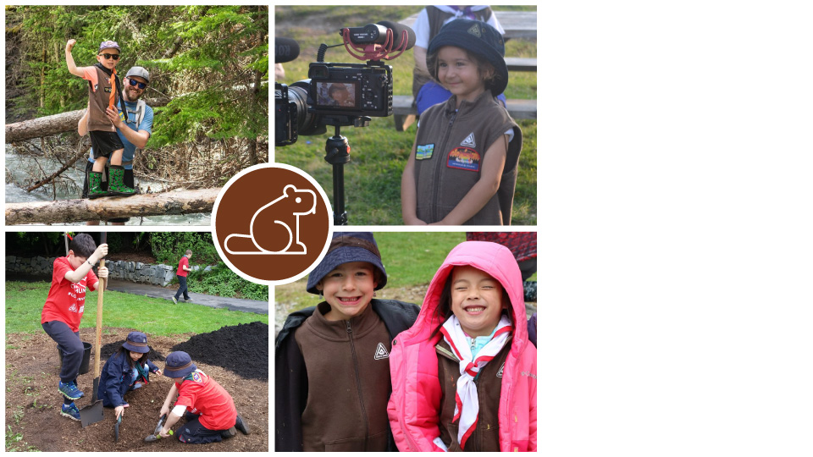
Beaver Scouts
(Age 5–7)
Learn about:
Sharing, the environment,
teamwork, and an introduction
to Plan, Do, Review as the basis for
setting goals and achieving them
The lingo:
Colony = a team.
Each Colony is broken up into
small teams = Lodges
Each Lodge has a designated
Beaver (White Tail) to help them
along with the Scouters.

Slide 5
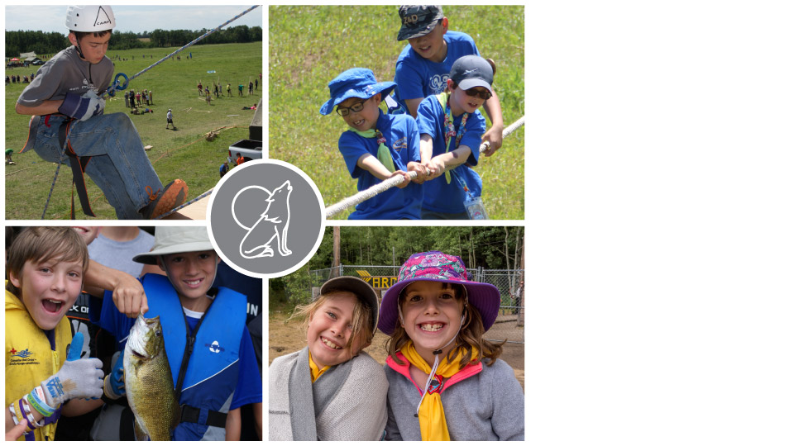
Cub Scouts
(Age 8–10)
Learn about:
Do Your Best (DYB), an introduction
to responsibility, peer teaching and the foundations of planning
The lingo:
Cub Pack = a team
Each Pack is broken up into small teams = Lairs.
Each Lair has a designated Cub (Howler—usually 3rd year youth) who helps the Lair, along with
the Scouters.

Slide 6
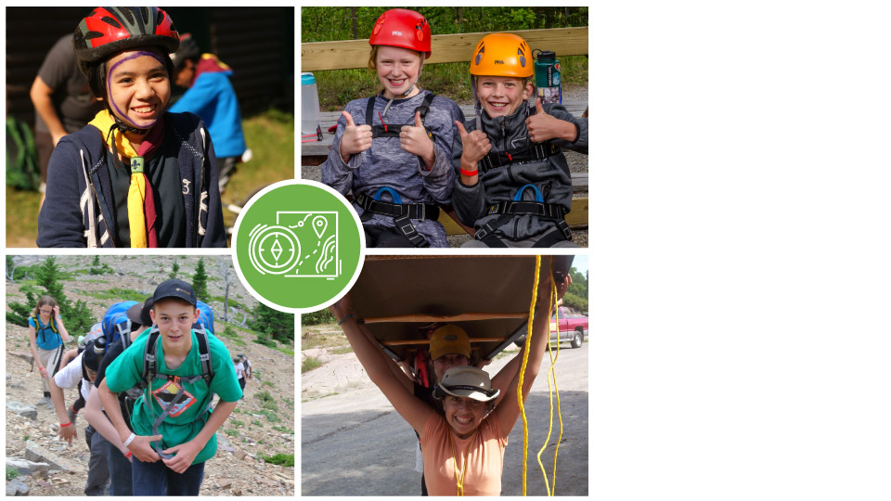
Scouts
(Age 11–14)
Learn about:
Developing independence, increasing self-confidence and
in-depth planning
The lingo:
Troop = a team
The Troop is broken up into small teams = Patrols.
Each Patrol has a designated Scout (typically a 3rd year Scout “Patrol Leader”) to help guide them, along with the Scouters.

Slide 7
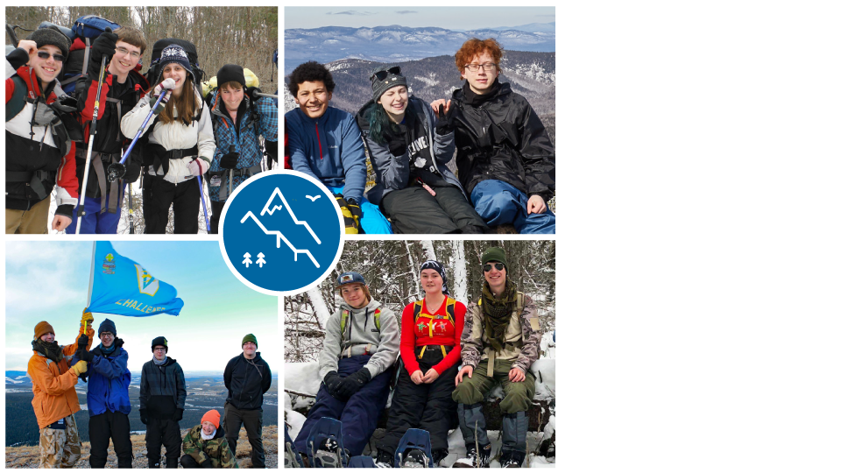
Venturer
Scouts
(Age 15–17)
Discover:
What they’re capable of and how it connects with the communities in which they live—deepening their leadership & resilience skills.
The lingo:
Venturer Company = a team
The Company will designate a Youth Leadership Team from their members, to help guide
them through the year.

Slide 8
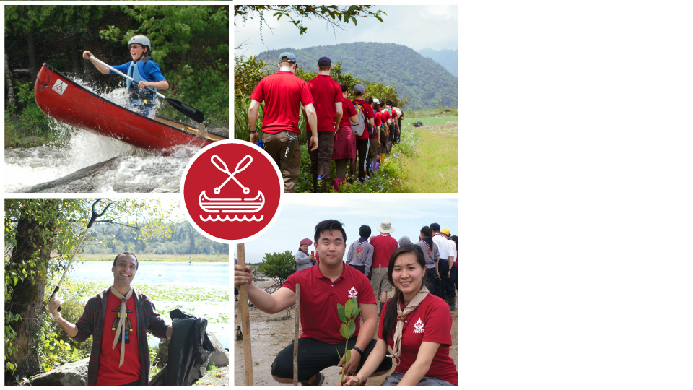
Rover Scouts
(Age 18–26)
Learn:
To use self-discovery, adventure and abilities to progress through young adulthood.
The lingo:
Crew = a team
Each Crew will designate a participant leadership team to
help them function and plan through the year.

Slide 9


How does our program develop youth to make a
meaningful contribution towards creating a better world?
Outdoor Adventure Skills
Badges
Personal Achievement
Badges
Set by youth
Based on personal interests
9 skills with 9 levels
Scouting Youth pave their own path to outdoor adventure and fun by setting their own goals, creating organized plans to achieve these goals and collectively reflecting on their experiences and personal development.
Along the way, youth are surrounded by committed and passionate Scouters who create a safe and inclusive environment for youth to discover the best in themselves.

Slide 10
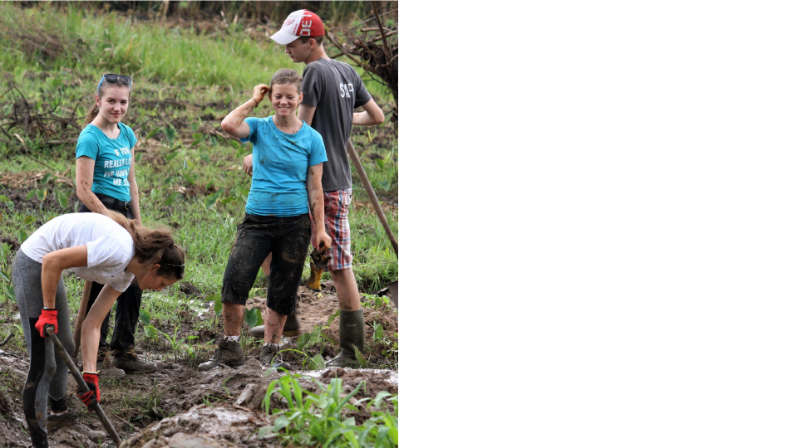

Scouts for Sustainability
While Scouting youth are already known for leading environmental and social causes to benefit the world around them, in 2019 alone, Scouting youth contributed to thousands of service projects, resulting in many Canadian communities being positively impacted by local Scouting initiatives.
Empower youth to
make a difference, moving from individual actions to collective acts and advocacy for causes affecting their communities.

Slide 11

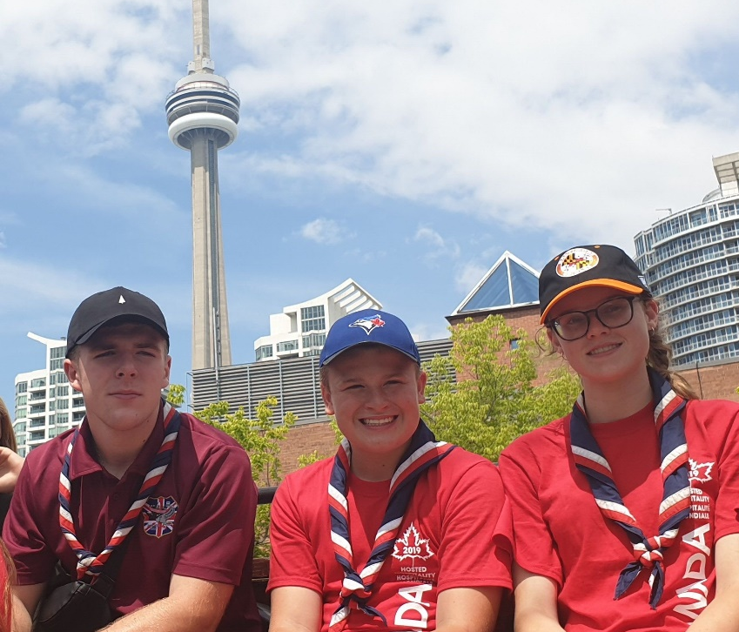
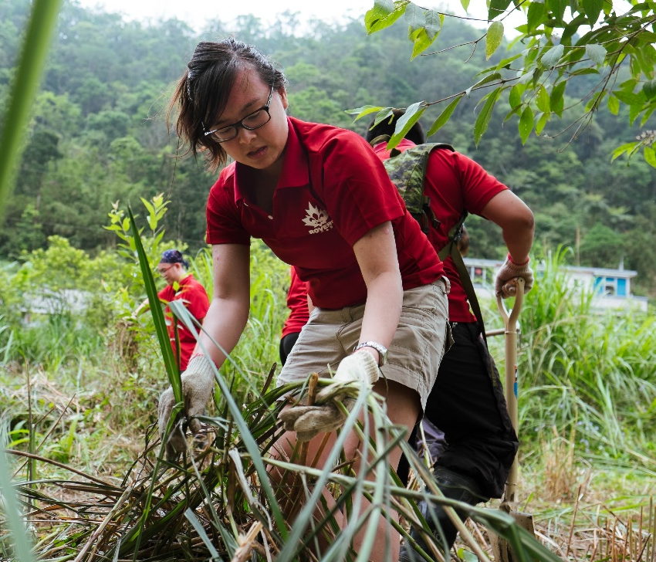
Unique Opportunities For Scouting Youth
Youth Leadership experience
On each level of Scouting, from Group to National, we hold openings for youth commissioners. The important job of these well chosen young leaders is to be the voice of the youth.
A challenge program of activities for youth between the ages of 14 and 25. The Award is an accomplishment that is widely recognized and highly regarded—it can be an outstanding addition to your resume or to a postsecondary application!
International experiences
Scouting is a worldwide movement and ScoutsAbroad is a way for every member of Scouts Canada to get out into the world. Through the different sections of this program, everyone will develop an understanding of the world and their place in it.

Slide 12

Our Culture of Safety—Scouts.ca/Safety
Safe and happy
activities
Safe Scouting
Youth “tool” permits
We have a department at
our national office which is specifically dedicated to
Safe Scouting.
Safe Scouting guides volunteers and staff through Safety reviews anytime a complaint, concern or incident is reported.
Troop age youth can learn and earn “permits” to safely use:
Match and fire
Axe and saw
Stoves and lanterns
Knife safety
Ratio—the youth to adult ratio is 8:1 for Beavers Cubs and Scouts.
There must always be 2 Scouters present with youth at all times.
Speak to your Section Scouters or Group Commissioner
if you need to report an incident or have a concern.

Slide 13
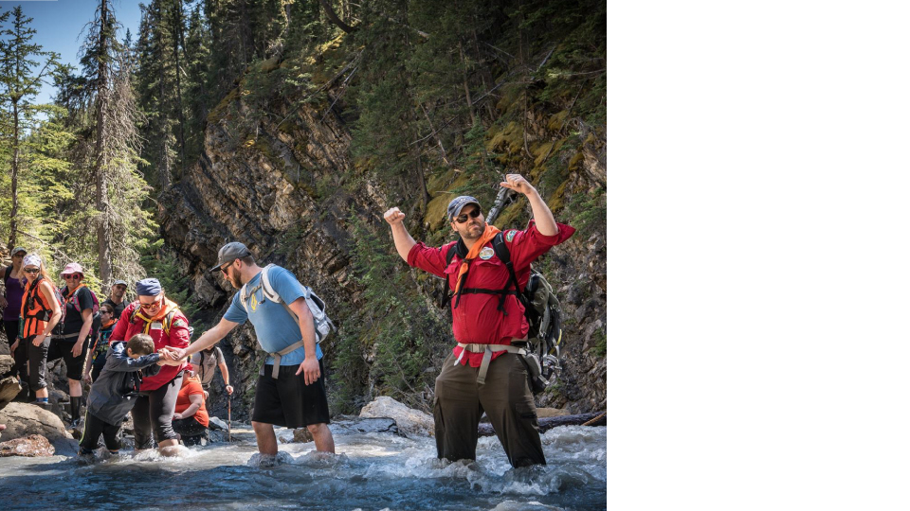

We look forward to having you
as a part of
the family!
Explorers
Needed
Whether you are a guest speaker, sharing a skill or trade, helping out at regular meetings or assisting the Group with fundraising, you are a vital
and invaluable part of
our organization.

Slide 14
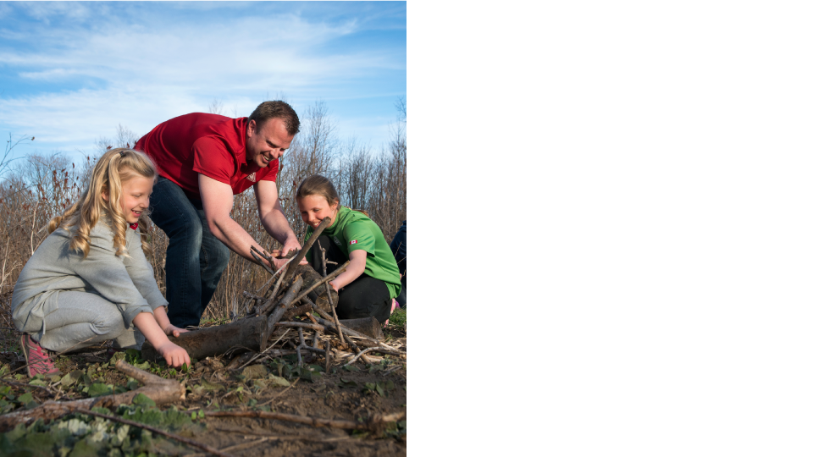
Note: To assist with youth activities you must be screened in accordance with Parent Helper requirements.
For more info: Scouts Canada’s Volunteer Screening Policy
How can I get involved as
a parent?
Gather materials
Shop for an upcoming event/camp
Assist with youth activities
Help with Fundraisers
Share my skills such as Property Management, Event Management, Communications etc.

Slide 15
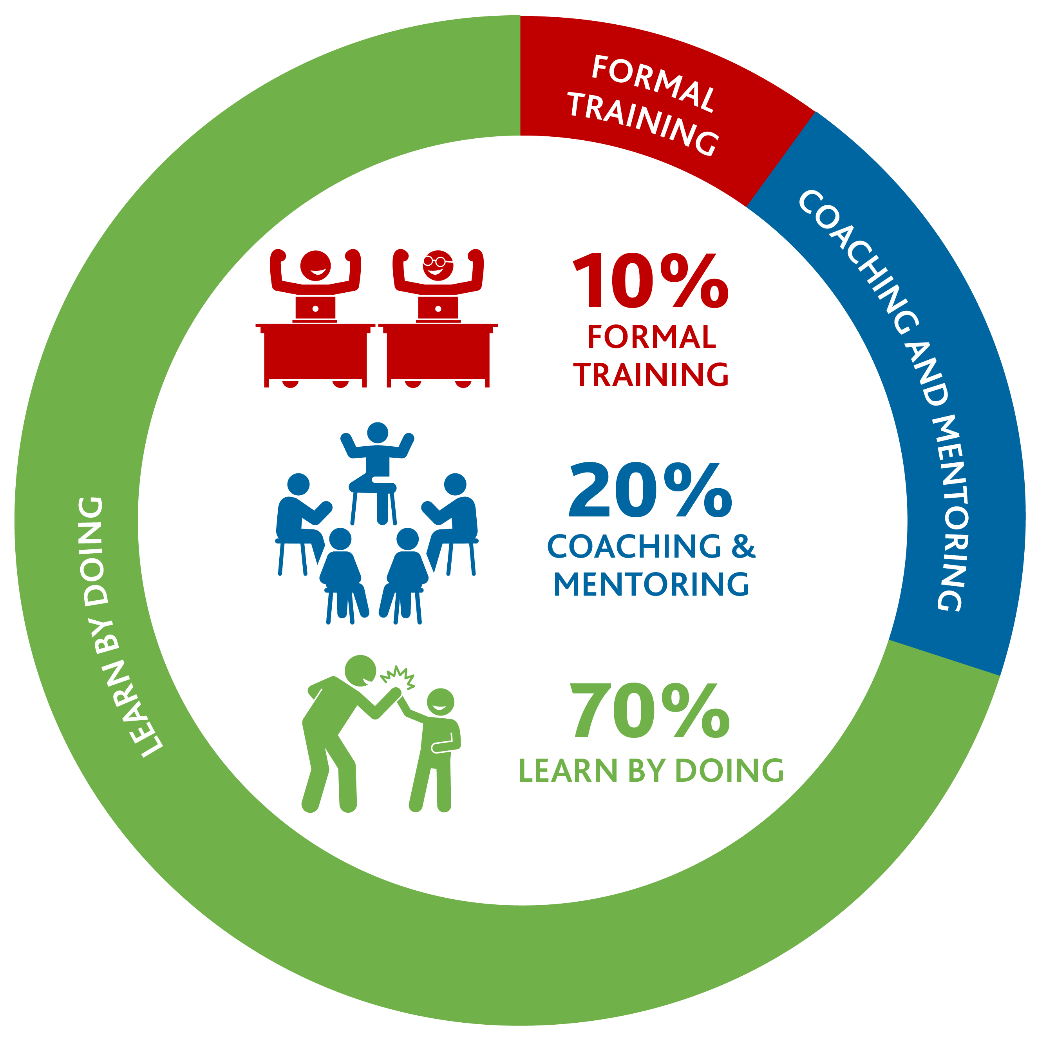
Become a Scouter—
It’s Fun & Rewarding
Our unique Scouter development model encourages you to jump right in and have an immediate impact.
Did we also mention that you will have FUN?

Slide 16
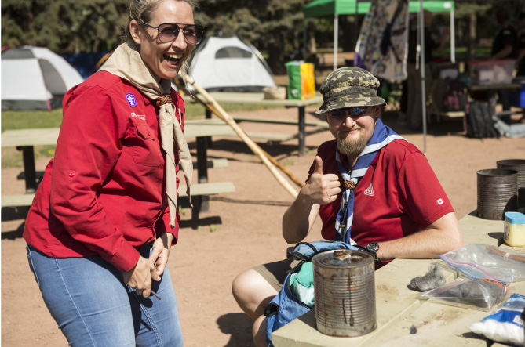
Other Training and
Engagement Opportunities
National/Regional Scout Cons
Scouter Mug Ups
Online courses—David Huestis Learning Centre
  Volunteer Screening for Youth Safety
First aid
Code of Conduct (CoC)
Reference checks (Ref)
Interview (Int)
Police Record Check/Vulnerable Sector Check (PRC/VSS)
White Water Rafting

Slide 17

Some interesting facts about Scouts
The Scout Movement was founded in 1907 by
Lord Robert Baden-Powell.
The Canadian General Council of the Boy Scout Association was incorporated by an act of the Canadian Parliament on June 12, 1914.
Beavers (Ages 5 to 7) were added to the Scouts Canada program in 1994.
In 1972, Scouts Canada began accepting female participants as part of its Rover Section. In 1992,
co-ed Scouting was an option for all program
sections and became policy for all sections in 1998.
The World Organization of the Scout Movement (WOSM) is made up of 171 National Scout Organizations all over the world with over 54
million Scouts participating worldwide.
Scouts Canada has 20 Councils that represent all members within each Province/Territory in Canada with over 50,000 youth participating yearly and 16,000 volunteers.
The strength of our program is the variety of experiential learning, mostly outdoors and
in small teams that has a positive impact
on our youth.

Slide 18
Online Program Material
Links and Resources
Scouts for Sustainability: Scouts.ca/programs/scouts-for-sustainability/overview.html
The Great Canadian Scouting Adventure: Scouts.ca/programs/great-canadian-scouting-adventure/explore.html
Personal Achievement Badge Portal: Scouts.ca/programs/canadian-path/personal-achievement-badges/overview.html
Activity Finder: Scouts.ca/resources/activity-finder.html
No One Left Behind Subsidy Program: Scouts.ca/donate/overview.html
Online Scout Shop: Scoutshop.ca/
New Scouter Welcome Kit: Scoutsca.s3.amazonaws.com/2019/01/nswk.pdf
Outdoor Adventure Skills Badges: Competencies and Requirements Scouts.ca/programs/canadian-path/about/outdoor-adventure-skills.html
Safe Scouting: Scouts.ca/safety/
Program Information (all sections): Scouts.ca/programs/overview.html
Volunteer Information link: Scouts.ca/volunteer/overview.html

Slide 19
